Slide 1
Combining Hindsight Experience Replay (HER) with Hierarchical Reinforcement Learning (HRL)
Presented By: Armaan Sethi

Slide 2
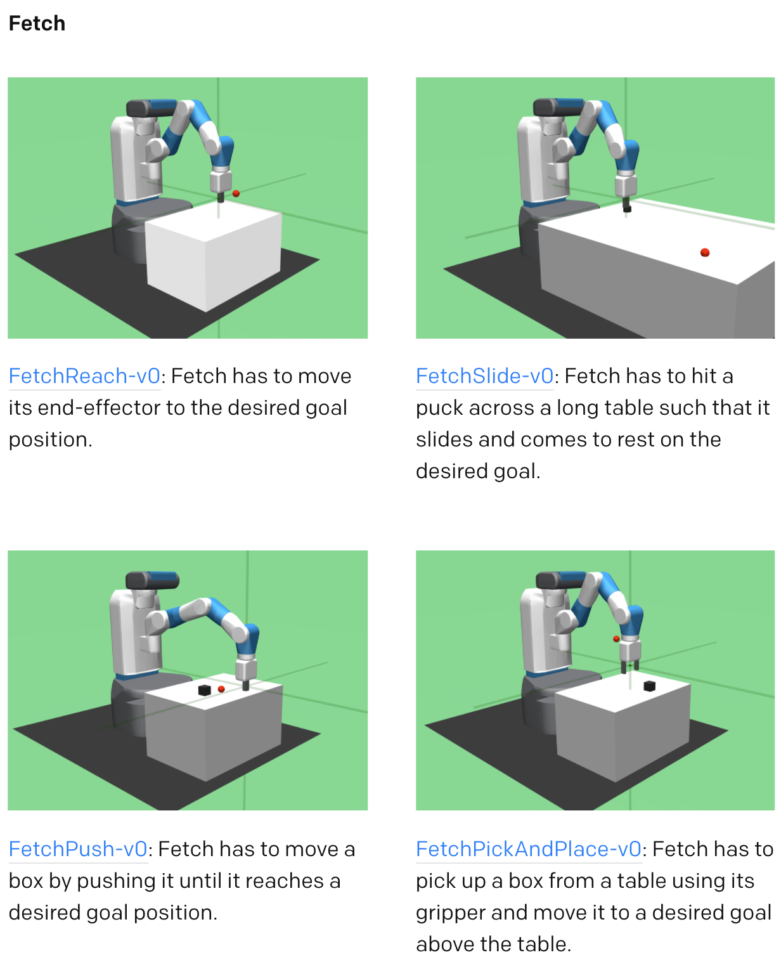
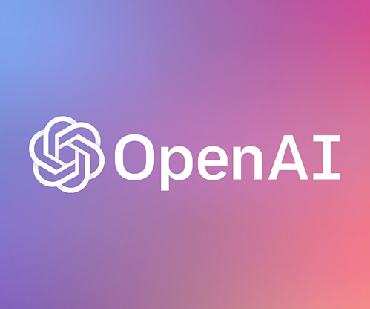

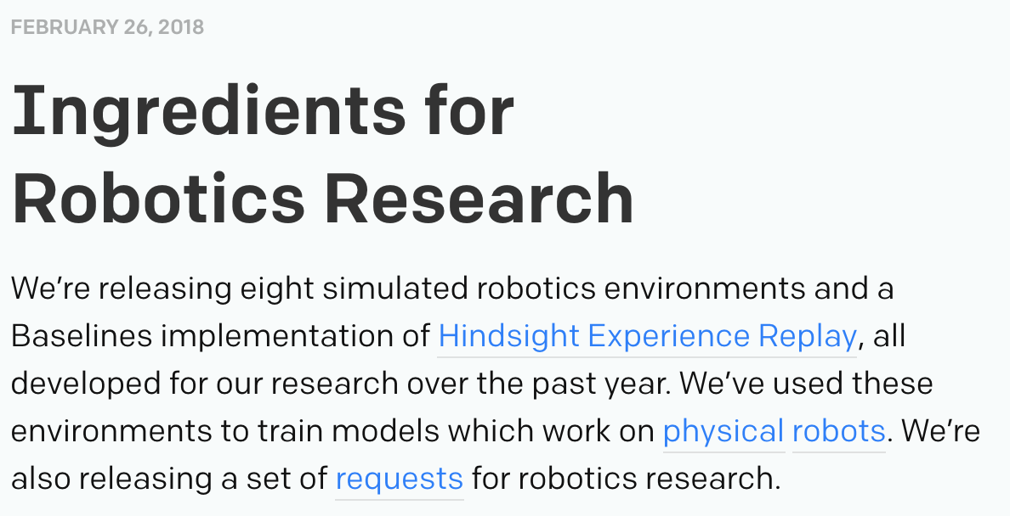
Overview

Slide 3

Motivation
Deep Reinforcement Learning is cool
MuJoCo Physics Engine
Multi-Joint dynamics with Contact

Slide 4
Why?
Without replay, training would be impossible
I didn’t think it would work in robotics
Translates to real robots

Slide 5
Previous Work
Hindsight Experience Replay
Learning from mistakes
Hierarchical Reinforcement Learning
Loosely defined
Learning Subtasks
Separating into Subtasks

Slide 6
The Task
Action Space
Observation Space
Step Function
Observation(object)
Reward(float)
Done(boolean)
Info(dict)
You don’t need to know
what these are

Slide 7
The Algorithm
Start with Reinforcement Learning Algorithm
DDPG - Deep Deterministic Policy Gradients
2 Neural networks, Actor-Critic
Actor outputs action (observation → action)
Critic gives feedback (action→ reward)
When fail
Replay the “same” scenario

Slide 8
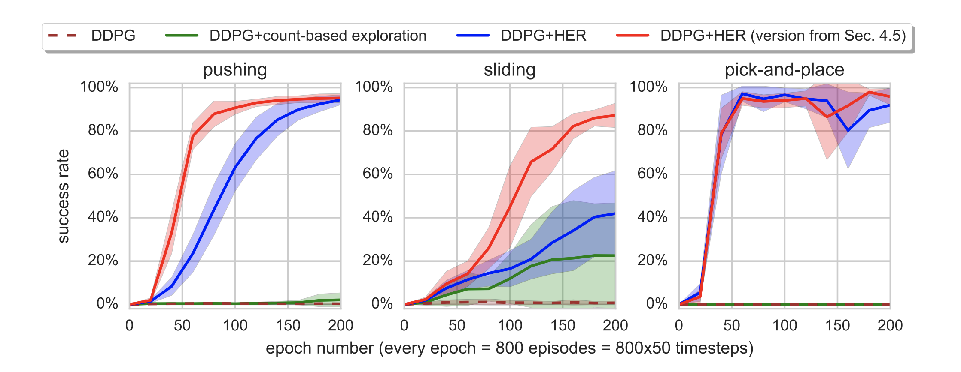
Evaluation
Tasks are already relatively simple
OpenAI is better

Slide 9
Final Thoughts
Few tasks
Simple tasks
Obstacles
Don’t need to know spaces
Observation
Action

